Slide 1
Computer Interfacing CSE 360 BRAC University

Slide 2
What is Computer Interfacing
In computing, an interface is a shared boundary across which two or more separate components of a computer system exchange information.
The exchange can be between software, computer hardware, peripheral devices, humans, and combinations of these.
Some computer hardware devices, such as a touchscreen, can both send and receive data through the interface, while others such as a mouse or microphone may only provide an interface to send data to a given system.
The place at which independent systems meet and act or communicate with each other examples: human - machine interface (analogue-machine interface) terminal - network interface (TTL - CMOS interface), parallel or serial interface

Slide 3
Peripheral and Peripheral Devices
A peripheral is a device that is connected to a host computer, but not part of it. It expands the host`s capabilities but does not form part of the core computer architecture. It is often, but not always, partially or completely dependent on host.
A peripheral or peripheral device is ancillary device used to put information into and get information out of the computer.
Three categories of peripheral devices exist based on their relationship with the computer:
Input Device
Output Device
Input/output Device

Slide 4
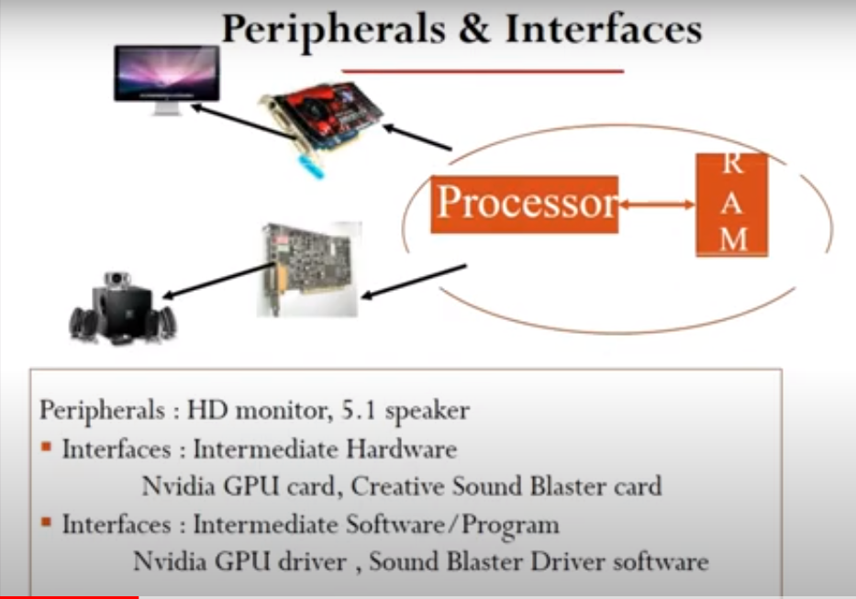

Slide 5
Categories of Peripheral Devices
Input device sends data or instructions to the computer, such as a mouse, keyboard, graphics tablet, image scanner, barcode reader, game controller, light pen, light gun, microphone, digital camera, webcam, dance pad, and read-only memory.
Output device provides output from the computer, such as a computer monitor, projector, printer, headphones and computer speaker.
Input / output device performs both input and output functions, such as a computer data storage device (including a disk drive, USB flash drive, memory card and tape drive).

Slide 6
Interface and its types
A computer without any interface is completely useless and would be like a house that has no door and no window.
All computers must have interfaces to input information and to output information or to output control action. Interfaces can be internal or external.
There are many types of internal and external processor interfaces.
Internal Interface
Internal interfaces of processor are for access to internal memory, internal timers, internal comparators, and other internal resources of the processor chip which the CPU of the processor can access. Unlike, external interfaces, internal interfaces have no pins.

Slide 7
Interface and its types
External interface
Every processor chip has pins for making electrical connections with the outside. Some pins on the processor chip are reserved for providing external interfaces. External interfaces are also called I/Os (Input / Output) to input information from outside and output information to outside the chip.
External input interfaces pins are for sensing ON/OFF switches, temperature sensor, humidity sensor, light sensor, voltage, etc.
External outputs interfaces pins are for controlling of ON/OFF switches, increasing or decreasing values of control devices and equipment, such as speed of motors, temperature of heaters, etc.

Slide 8
Interface and its types
Hardware interfaces exist in many of the components, such as the various buses, storage devices, other I/O devices, etc.
A hardware interface is described by the mechanical, electrical and logical signals at the interface and the protocol for sequencing them (sometimes called signaling).
Software interface may refer to a wide range of different types of interface at different "levels": an operating system may interface with pieces of hardware.
Applications or programs running on the operating system may need to interact via data streams, filters, and pipelines.

Slide 9
Interface and its types
Serial or Parallel Interface
Interfaces can also be classified as either serial interface or parallel interface.
Serial interface: uses one pin or one wire or one copper track for receiving or for transmitting data to destination sequentially one bit at a time.
Serial interface can be thought as door to ‘single lane highway’
For example, UART serial interface uses several external pins on the processor chip
Parallel interface: unlike serial interface, parallel interface uses several pins or several copper tracks, to send or to receive data bits simultaneously in parallel, such as 8-bit byte, 16-bit data, 32-bit data etc.
Parallel interface can be thought as door to ‘multi-lane highway’.
Example of parallel internal interface is data-bus and address-bus that does not use pins.

Slide 10
Why Computer Interfacing is Necessary
The human - machine interface determines the ultimate success or failure of many computer- based systems.
Digital systems exist within and must successfully interact with an analogue natural environment (Digital – analogue interfaces are unavoidable)
Rather than designing digital systems from elementary components, computer engineers more typically assemble new systems from existing subsystems.
Basically, the user interface is always needed in order to send instructions or to receive feedback from the computer, otherwise it will be a useless box of circuitry without the ability to interact with us.
By building interfaces on top of that we can make using computers much more productive and accessible for the majority of people.

Slide 11
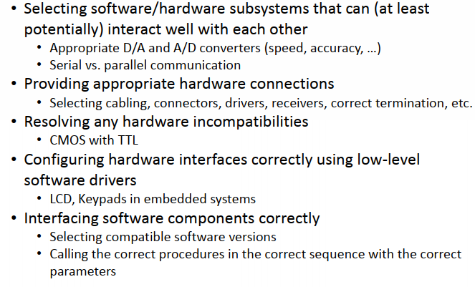
Typical Interfacing Activities

Slide 12
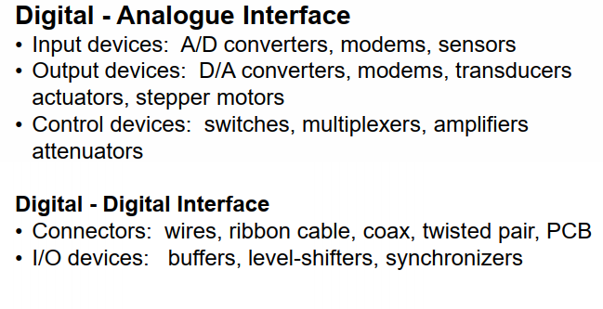
Some Interface Examples

Slide 13
The End

